Slide 1
Chemistry 3A
Introductory General Chemistry
Comparing Gases to Solids, Liquids; Pressure;
Kinetic Molecular Theory as a Model for Gases;
The Gas Laws of Boyle, Charles, Gay-Lussac, Avogadro; Ideal Gas Law
S. M. Halloran

Slide 2
Comparing Gases to Solids, Liquids
Pressure
Kinetic Molecular Theory as a Model for Gases
The Gas Laws of Boyle, Charles, Gay-Lussac, Avogadro
Ideal Gas Law and Applying It
Understanding Gas Mixtures

Slide 3
Comparing Solids/Liquids/Gases
H₂O has same chemical properties whether as steam (water vapor), water, or ice, but physical properties differ
Covalent bonds affect molecular shape/geometry, bond energies, chemical properties
Intermolecular forces set the physical properties of liquids and solids
Kinetic molecular theory is used to explain properties of gases, but needs adjustments when gases become so dense they behave almost like liquids

Slide 4
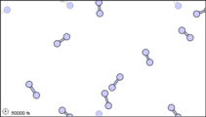
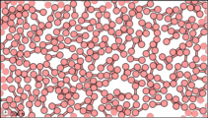
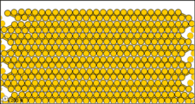
Comparing Solids/Liquids/Gases
A substance’s state can be described as
  Kinetic energy (moving around) of individual particles (molecules or atoms)
  Temperature affects or indicates kinetic energy
  The nature of intermolecular forces which are generally involved in attraction between molecules
Both temperature and pressure affect gases
Increasing pressure (which is a kind of density) also increases intermolecular forces

Slide 5
Properties of Gases, Liquids, Solids
Gases | Molecules widely separated Particle kinetic energy greater than intermolecular attractions Molecules fill container easily Non-ideal gas behavior occurs if attractive forces become significant
Liquids | Intermolecular attractive forces become significant such that liquid states form from gas states Liquids are not compressible and certainly denser than gases Liquids show a definite volume which does not depend on container size or shape Intermolecular attractive forces are not strong enough to fix position of molecules, so molecules and move around each other
Solids | Intermolecular attractive forces are such that molecules can be locked or fixed in position These solids like liquids are not compressible If the molecules forming the solid adopt an ordered packing arrangement, they can become crystalline

Slide 6

Pressure
Pressure is the physical property of a gas
$Pressure= \frac{Force}{Area}$
A TON of conversion factors for pressure
How many atmospheres in 595 torr?
$$595 torr ×\frac{1 atm}{760 torr}=0.783 atm$$
1 atmosphere (atm) [chemists] Expect to work with this in your calculations
= 760 millimeters of mercury (mm Hg) [meteorlogists]
= 760 torr (named after Italian scientist) [STEM people]
= 101,325 Pascal (Pa) [SI unit] = 101.325 kilopascals (kPa)
= 14.7 pounds per square inch (psi)
= 1.01325 bar

Slide 7

Problem Practice
1 atmosphere (atm) [chemists] Expect to work with this in your calculations
= 760 millimeters of mercury (mm Hg) [meteorlogists]
= 760 torr (named after Italian scientist) [STEM people]
= 101,325 Pascal (Pa) [SI unit] = 101.325 kilopascals (kPa)
= 14.7 pounds per square inch (psi)
= 1.01325 bar
How many atmospheres in 1,022 torr?
$$1022 torr ×\frac{1 atm}{760 torr}=1.345 atm$$
The atmosphere on Mars is largely CO₂ at a pressure of 6.01 mmHg. What is this pressure in atmospheres?
$$6.01 mm Hg ×\frac{1 atm}{760 mm Hg}=0.00791 atm=7.91 ×{10}^{−3} atm$$
Atmospheric pressure is low in the eye of a hurricane. In a 1979 hurricane in the Pacific Ocean, a pressure of 0.859 atm was reported inside the eye. What is this pressure in torr?
$$0.859 atm ×\frac{760 torr}{1 atm}=652 torr$$

Slide 8

Problem Practice
1 atmosphere (atm) [chemists] Expect to work with this in your calculations
= 760 millimeters of mercury (mm Hg) [meteorlogists]
= 760 torr (named after Italian scientist) [STEM people]
= 101,325 Pascal (Pa) [SI unit] = 101.325 kilopascals (kPa)
= 14.7 pounds per square inch (psi)
= 1.01325 bar
Remember the initial setup: this is about conversions and conversion factors. Set up an equation, result to right of equal symbol, build of calculation to the left. Put all inputs to left, put “? units” to right
$$0.859 atm ×… = ? torr$$
Find the one or more conversion factors that take you to the result. This shows you want to find a conversion with “torr” & “atm” as units. From above, 1 atm = 760 torr will directly lead to converted result
$$0.859 atm×\frac{760 torr}{1 atm}=653 torr$$

Slide 9
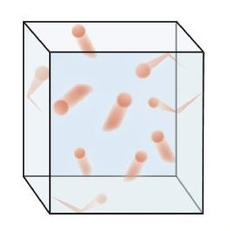
Kinetic Molecular Theory (KMT)
Also called “Kinetic [Molecular] Theory of Gases”
Principles/Assumptions
Gases are tiny particles in constant motion
Gases collide elastically with each other
and walls of container. In elastic collisions,
no energy is lost.
  Kinetic energy = ½ mv² so that means the
  magnitude of the velocity v is unchanged even
  though the direction of the velocity is changed (velocity is a vector!)
Gas particles are separated by large distances, relative to their own size
There can be no attractive or repulsive forces between the particles: this makes gases “non-ideal”.
  Too strong an attractive force can cause liquid formation
The average speed is dependent on temperature
  Temperature is an indicator of (heat) energy

Slide 10
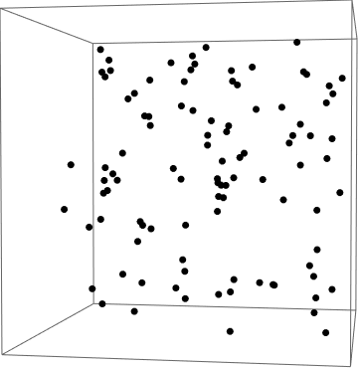
Gas Laws
In the 15th to 17th centuries
scientists did experiments
with gases in which they
discovered properties they
could reliably reproduce
From the results, gas laws
were described that
developed the mathematics
to explain behavior of the gases
These laws are described next

Slide 11
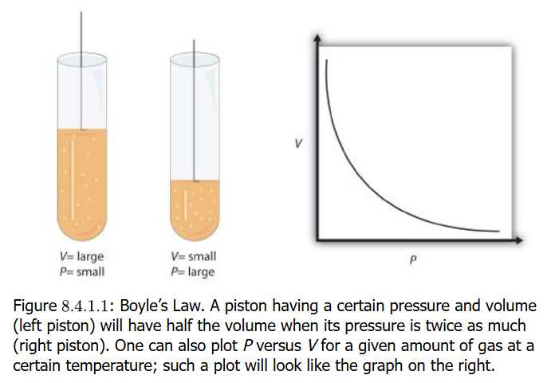
Boyle’s Law (PV=k)
1662: Boyle noted that
if a gas is kept at
constant temperature,
that if the volume of the
is increased, the
pressure of the gas
decreases
He also noted if the volume of the gas is decreased again at constant temperature, the pressure is increased
The mathematical description of this observation is the hyperbola plot shown in the figure. This shows that volume (V) times pressure (P) is a constant (k)

Slide 12
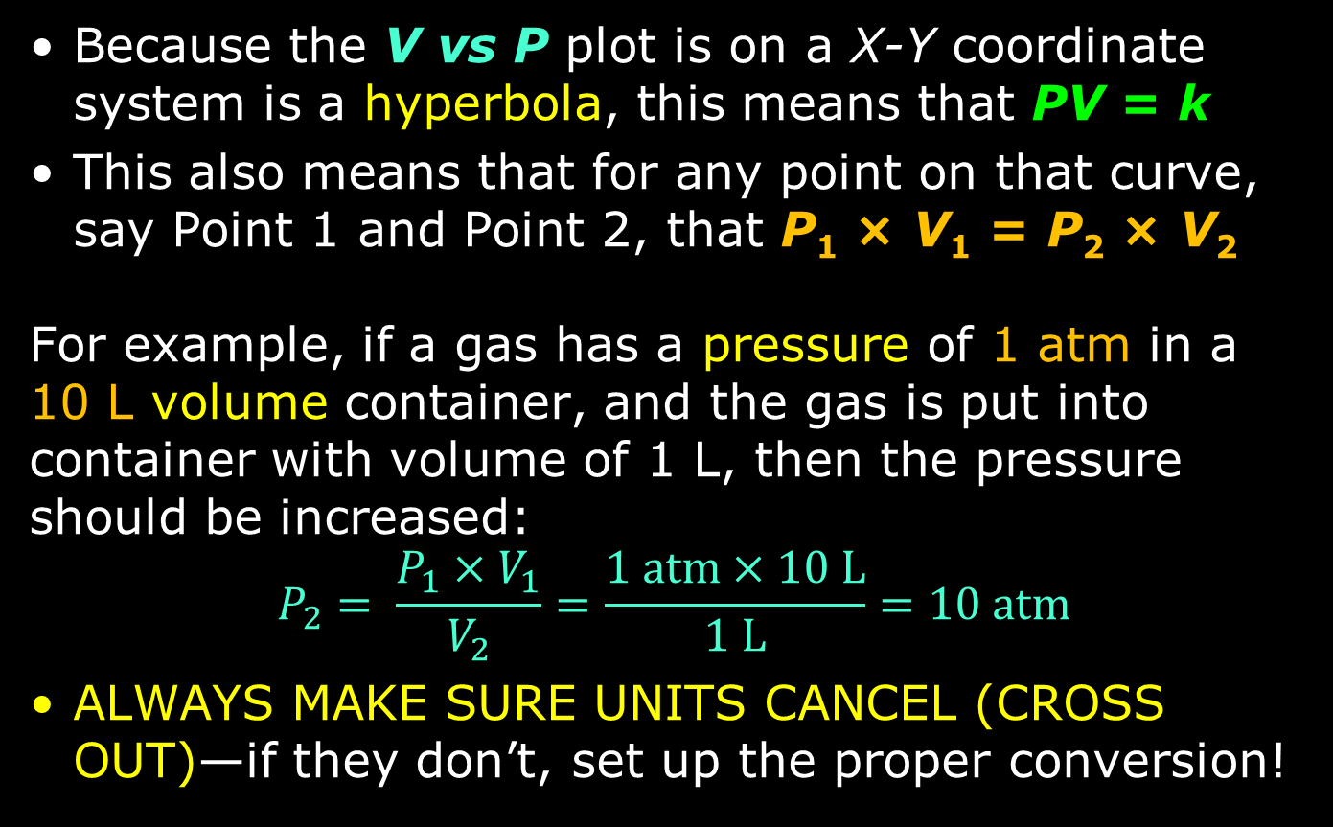
Boyle’s Law (PV=k)
Because the V vs P plot is on a X-Y coordinate system is a hyperbola, this means that PV = k
This also means that for any point on that curve, say Point 1 and Point 2, that P₁ × V₁ = P₂ × V₂
For example, if a gas has a pressure of 1 atm in a
10 L volume container, and the gas is put into container with volume of 1 L, then the pressure should be increased:
$$P_{2}= \frac{P_{1}×V_{1}}{V_{2}}=\frac{1 atm×10 L}{1 L}=10 atm$$
ALWAYS MAKE SURE UNITS CANCEL (CROSS OUT)—if they don’t, set up the proper conversion!

Slide 13
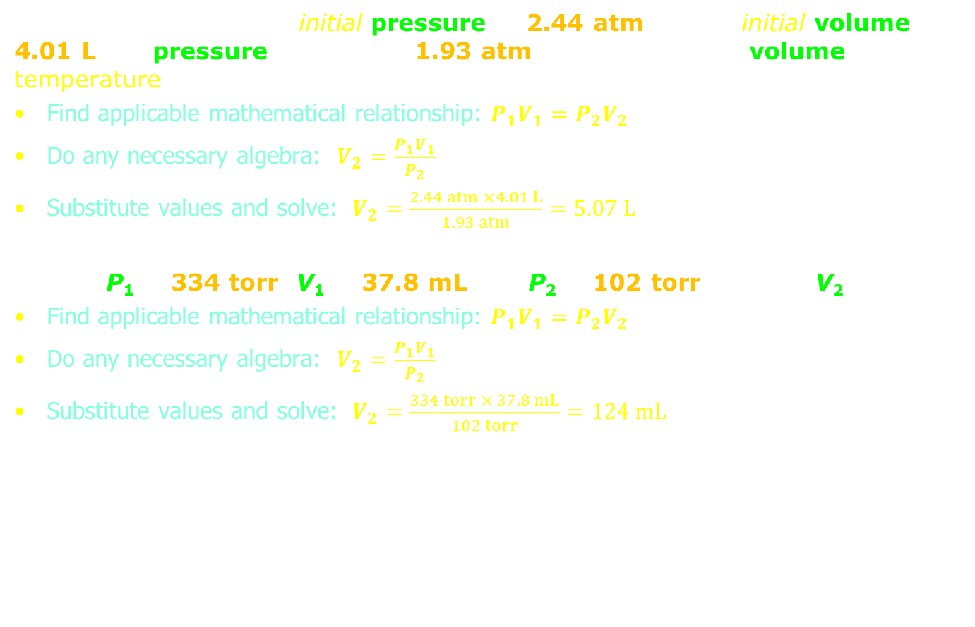
Problem Practice
A sample of gas has an initial pressure of 2.44 atm and an initial volume of 4.01 L. Its pressure changes to 1.93 atm. What is the new volume if temperature?
Find applicable mathematical relationship: $P_{1}V_{1}=P_{2}V_{2}$
Do any necessary algebra: $V_{2}=\frac{P_{1}V_{1}}{P_{2}}$
Substitute values and solve: $V_{2}=\frac{2.44 atm ×4.01 L}{1.93 atm}=5.07 L$
Solve: P₁ = 334 torr, V₁ = 37.8 mL and P₂ = 102 torr. What is V₂?
Find applicable mathematical relationship: $P_{1}V_{1}=P_{2}V_{2}$
Do any necessary algebra: $V_{2}=\frac{P_{1}V_{1}}{P_{2}}$
Substitute values and solve: $V_{2}=\frac{334 torr × 37.8 mL}{102 torr}=124 mL$

Slide 14
Problem Practice
A sample of gas has an initial pressure of 722 torr and an initial volume of 88.8 mL. Its volume changes to 0.663 L. What is the new pressure?
Find applicable mathematical relationship: $P_{1}V_{1}=P_{2}V_{2}$
Do any necessary algebra: $P_{2}=\frac{P_{1}V_{1}}{V_{2}}$
Substitute values: $P_{2}=\frac{722 atm × 88.8 mL}{0.663 L}$
If units don’t cancel (cross out), do conversions!:
$P_{2}=\frac{722 torr × \left(88.8 mL × \frac{1 L}{1000 mL}\right)}{0.663 L}$ OR $P_{2}=\frac{722 torr × 88.8 mL}{0.663 L × \frac{1000 mL}{1 L}}$
Result time: $P_{2}=96.7 torr$
Solve: P₁ = 308 torr, V₁ = 456 mL and P₂ = 1.55 atm. What is V₂?
Find applicable mathematical relationship: $P_{1}V_{1}=P_{2}V_{2}$
Do any necessary algebra: $V_{2}=\frac{P_{1}V_{1}}{P_{2}}$
Substitute values: $V_{2}=\frac{308 torr × 456 mL}{1.55 atm}$
If units don’t cancel (cross out), do conversions!:
$V_{2}=\frac{\left(308 torr × \frac{1 atm}{760 torr}\right) × 456 mL}{1.55 atm}$ OR $V_{2}=\frac{308 torr × 456 mL}{1.55 atm × \frac{760 torr}{1 atm}}$
Result time: $V_{2}=119 mL$
Find applicable mathematical relationship: $P_{1}V_{1}=P_{2}V_{2}$
Do any necessary algebra: $V_{2}=\frac{P_{1}V_{1}}{P_{2}}$
Substitute values and solve: $V_{2}=\frac{2.44 atm ×4.01 L}{1.93 atm}=5.07 L$
Solve: P₁ = 334 torr, V₁ = 37.8 mL and P₂ = 102 torr. What is V₂?
Find applicable mathematical relationship: $P_{1}V_{1}=P_{2}V_{2}$
Do any necessary algebra: $V_{2}=\frac{P_{1}V_{1}}{P_{2}}$
Substitute values and solve: $V_{2}=\frac{334 torr × 37.8 mL}{102 torr}=124 mL$

Slide 15
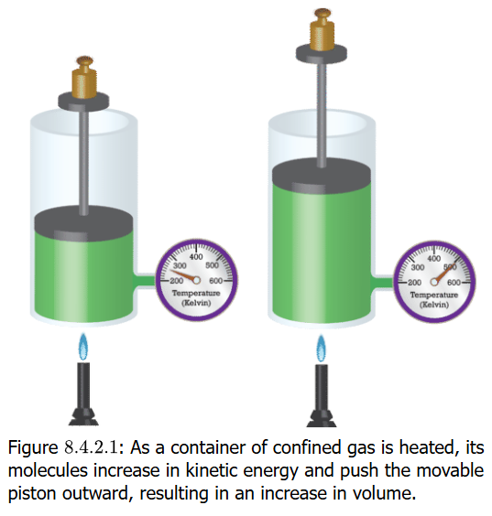
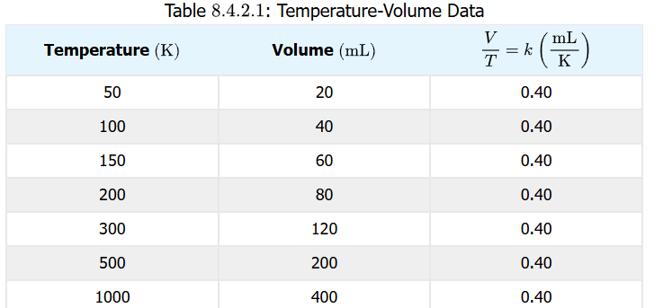
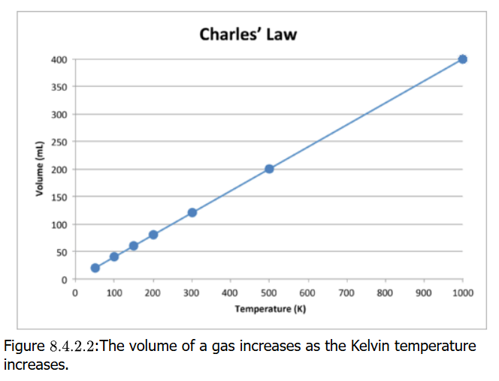

Charles’ Law (V=kT)
As a gas is heated (temperature (T) is monitored) with important part of keeping the pressure constant
In the process, the gas increases in volume (V) in a linearly constant way (k)
Temperate must be measured on the Kelvin scale for mathematical relation to work
$$V=kT → \frac{V}{T}=k$$
$$→ \frac{V_{1}}{T_{1}}=\frac{V_{2}}{T_{2}}$$

Slide 16
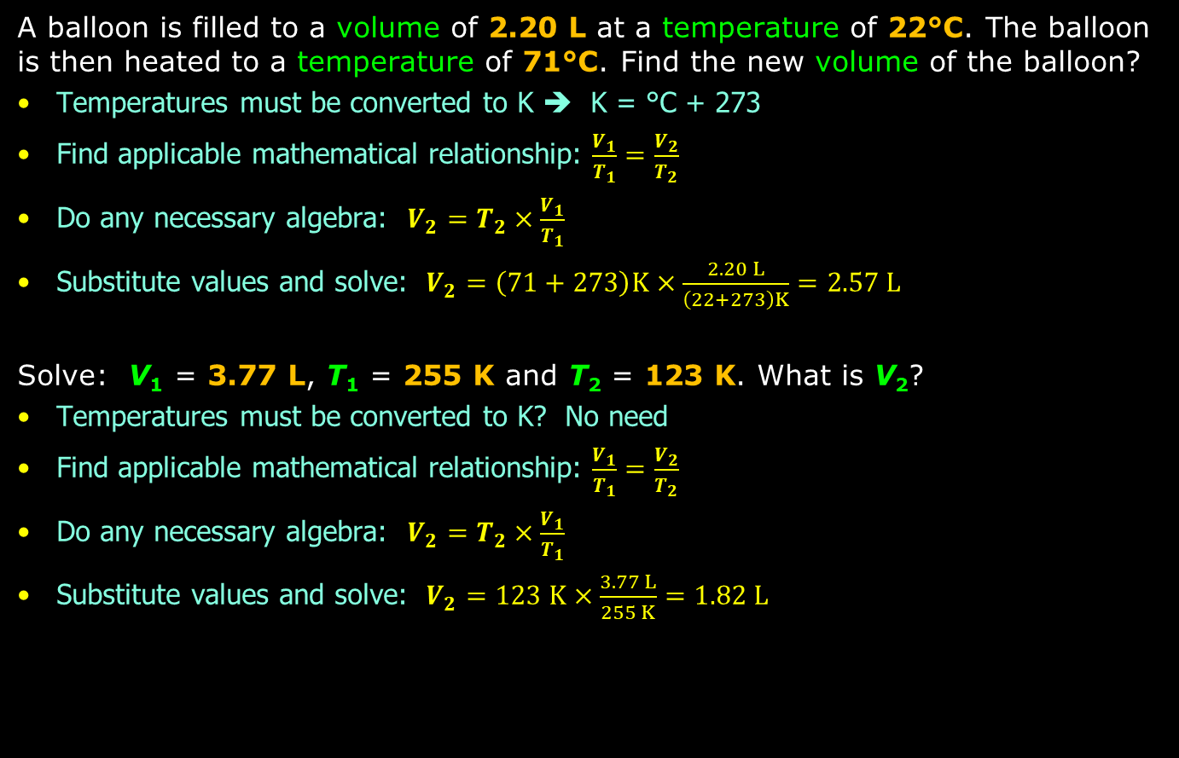
Problem Practice
A balloon is filled to a volume of 2.20 L at a temperature of 22°C. The balloon is then heated to a temperature of 71°C. Find the new volume of the balloon?
Temperatures must be converted to K ➔ K = °C + 273
Find applicable mathematical relationship: $\frac{V_{1}}{T_{1}}=\frac{V_{2}}{T_{2}}$
Do any necessary algebra: $V_{2}=T_{2}×\frac{V_{1}}{T_{1}}$
Substitute values and solve: $V_{2}=\left(71+273\right)K×\frac{2.20 L}{\left(22+273\right)K}=2.57 L$
Solve: V₁ = 3.77 L, T₁ = 255 K and T₂ = 123 K. What is V₂?
Temperatures must be converted to K? No need
Find applicable mathematical relationship: $\frac{V_{1}}{T_{1}}=\frac{V_{2}}{T_{2}}$
Do any necessary algebra: $V_{2}=T_{2}×\frac{V_{1}}{T_{1}}$
Substitute values and solve: $V_{2}=123 K×\frac{3.77 L}{255 K}=1.82 L$

Slide 17
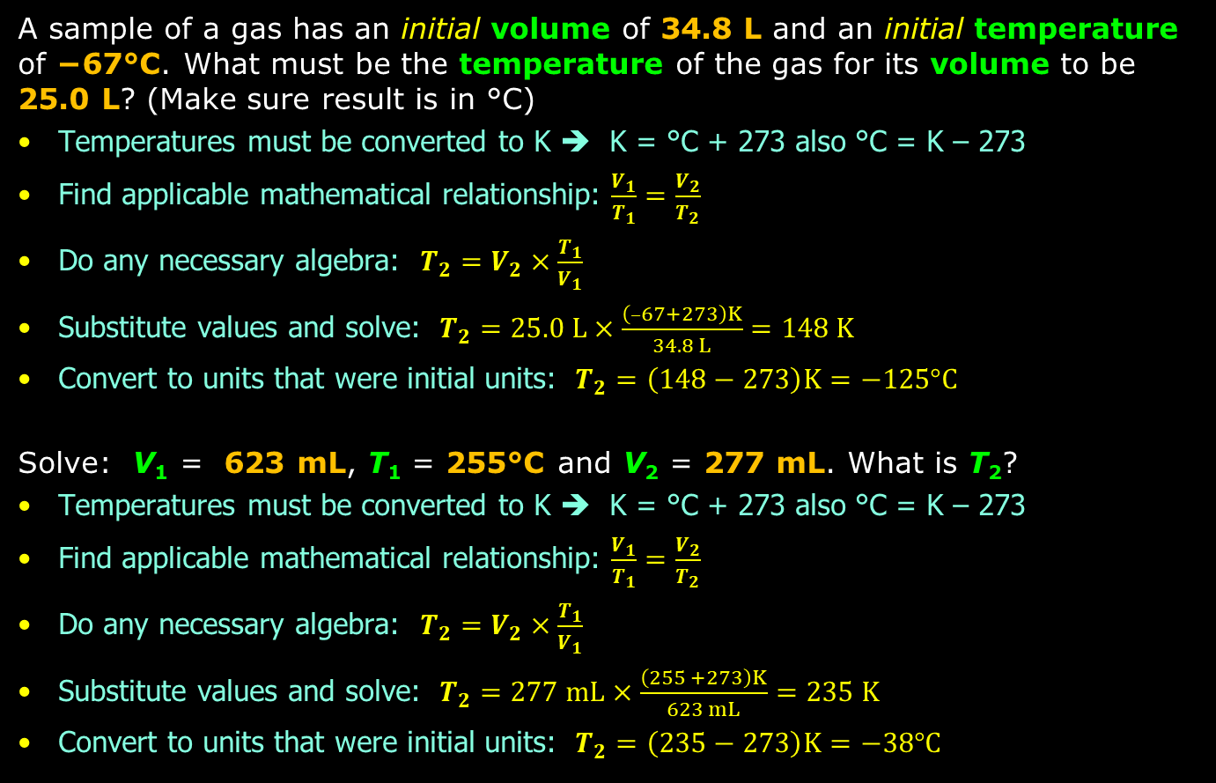
Problem Practice
A sample of a gas has an initial volume of 34.8 L and an initial temperature of −67°C. What must be the temperature of the gas for its volume to be
25.0 L? (Make sure result is in °C)
Temperatures must be converted to K ➔ K = °C + 273 also °C = K – 273
Find applicable mathematical relationship: $\frac{V_{1}}{T_{1}}=\frac{V_{2}}{T_{2}}$
Do any necessary algebra: $T_{2}=V_{2}×\frac{T_{1}}{V_{1}}$
Substitute values and solve: $T_{2}=25.0 L×\frac{\left(–67+273\right)K}{34.8 L}=148 K$
Convert to units that were initial units: $T_{2}=\left(148−273\right)K=−125°C$
Solve: V₁ = 623 mL, T₁ = 255°C and V₂ = 277 mL. What is T₂?
Temperatures must be converted to K ➔ K = °C + 273 also °C = K – 273
Find applicable mathematical relationship: $\frac{V_{1}}{T_{1}}=\frac{V_{2}}{T_{2}}$
Do any necessary algebra: $T_{2}=V_{2}×\frac{T_{1}}{V_{1}}$
Substitute values and solve: $T_{2}=277 mL×\frac{\left(255 +273\right)K}{623 mL}=235 K$
Convert to units that were initial units: $T_{2}=\left(235−273\right)K=−38°C$

Slide 18
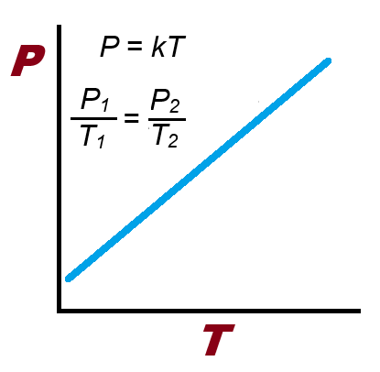
Gay-Lussac’s Law (P₁/T₁=P₂/T₂)
This particular gas law brings
in temperature as a factor in
how gases behave
The law states very simply
that as the temperature of a
gas in a container is increased,
the pressure of the gas is
increased in a linearly
constant way as well
The P vs T plot should be a straight line with positive slope (k > 0)

Slide 19
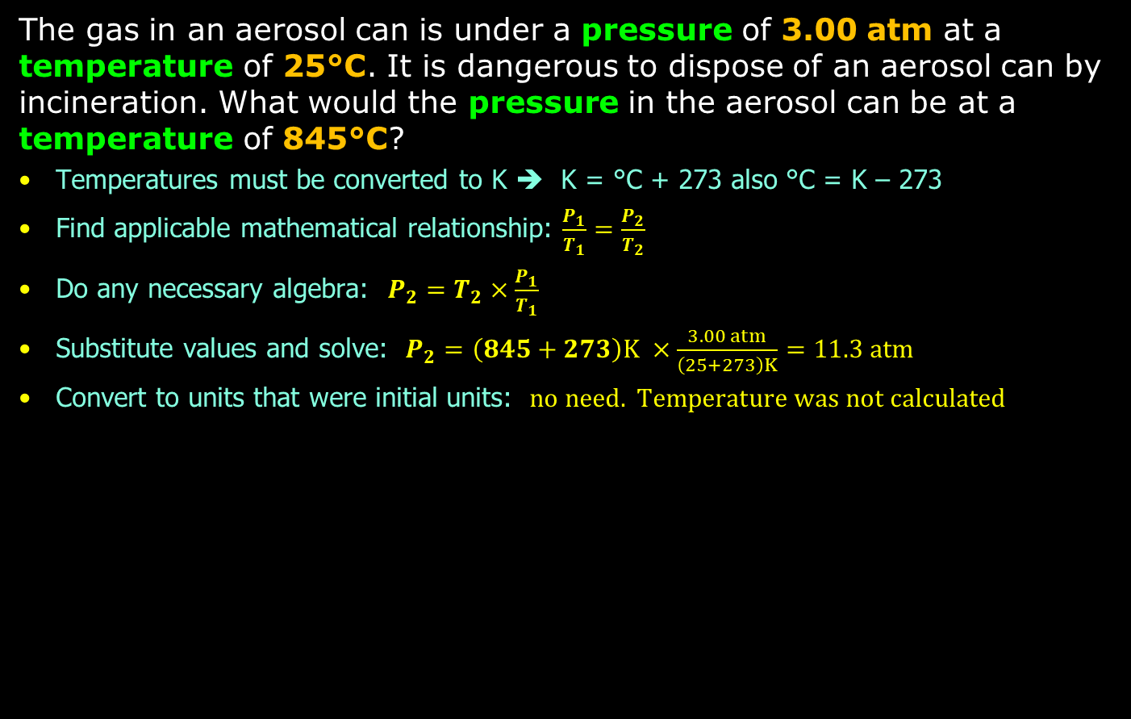
Problem Practice
The gas in an aerosol can is under a pressure of 3.00 atm at a temperature of 25°C. It is dangerous to dispose of an aerosol can by incineration. What would the pressure in the aerosol can be at a temperature of 845°C?
Temperatures must be converted to K ➔ K = °C + 273 also °C = K – 273
Find applicable mathematical relationship: $\frac{P_{1}}{T_{1}}=\frac{P_{2}}{T_{2}}$
Do any necessary algebra: $P_{2}=T_{2}×\frac{P_{1}}{T_{1}}$
Substitute values and solve: $P_{2}=\left(845+273\right)K ×\frac{3.00 atm}{\left(25+273\right)K}=11.3 atm$
Convert to units that were initial units: $no need. Temperature was not calculated$

Slide 20
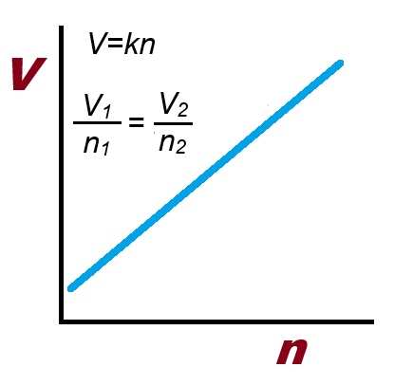
Avogadro’s Law (V=k × n)
Avogadro studied amounts of atoms
and molecules. The number of atoms
and molecules totaling 6.022 × 10²³
amounting to 1 mole is attributed to
Avogadro
Avogadro stated:
“Equal volumes of all gases, at
the same temperature and
pressure, contain the
same number of molecules”
Just like the P=kT gas law, the
V=kn gas law is a straight line with positive slope (k > 0)

Slide 21
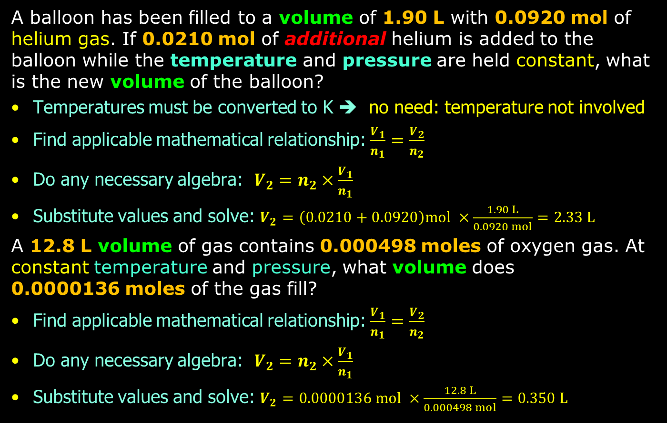
Problem Practice
A balloon has been filled to a volume of 1.90 L with 0.0920 mol of helium gas. If 0.0210 mol of additional helium is added to the balloon while the temperature and pressure are held constant, what is the new volume of the balloon?
Temperatures must be converted to K ➔ no need: temperature not involved
Find applicable mathematical relationship: $\frac{V_{1}}{n_{1}}=\frac{V_{2}}{n_{2}}$
Do any necessary algebra: $V_{2}=n_{2}×\frac{V_{1}}{n_{1}}$
Substitute values and solve: $V_{2}=\left(0.0210+0.0920\right)mol ×\frac{1.90 L}{0.0920 mol}=2.33 L$
A 12.8 L volume of gas contains 0.000498 moles of oxygen gas. At constant temperature and pressure, what volume does
0.0000136 moles of the gas fill?
Find applicable mathematical relationship: $\frac{V_{1}}{n_{1}}=\frac{V_{2}}{n_{2}}$
Do any necessary algebra: $V_{2}=n_{2}×\frac{V_{1}}{n_{1}}$
Substitute values and solve: $V_{2}=0.0000136 mol ×\frac{12.8 L}{0.000498 mol}=0.350 L$

Slide 22
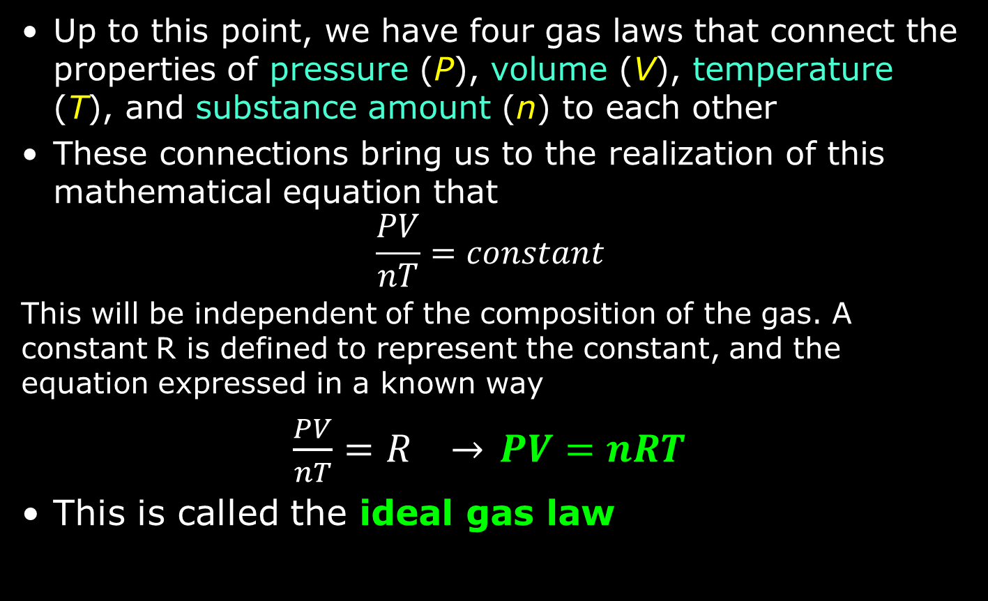
Ideal Gas Law (PV = nRT)
Up to this point, we have four gas laws that connect the properties of pressure (P), volume (V), temperature (T), and substance amount (n) to each other
These connections bring us to the realization of this mathematical equation that
$$\frac{PV}{nT}=constant$$
This will be independent of the composition of the gas. A constant R is defined to represent the constant, and the equation expressed in a known way
$\frac{PV}{nT}=R →$ $PV=nRT$
This is called the ideal gas law

Slide 23
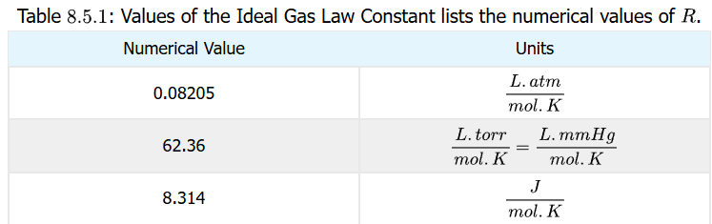
R, Ideal Gas Law Constant
The constant R in the PV=nRT gas law equation is experimentally determined and is true for all gases
Its value can be different depending on the units being utilized

Slide 24
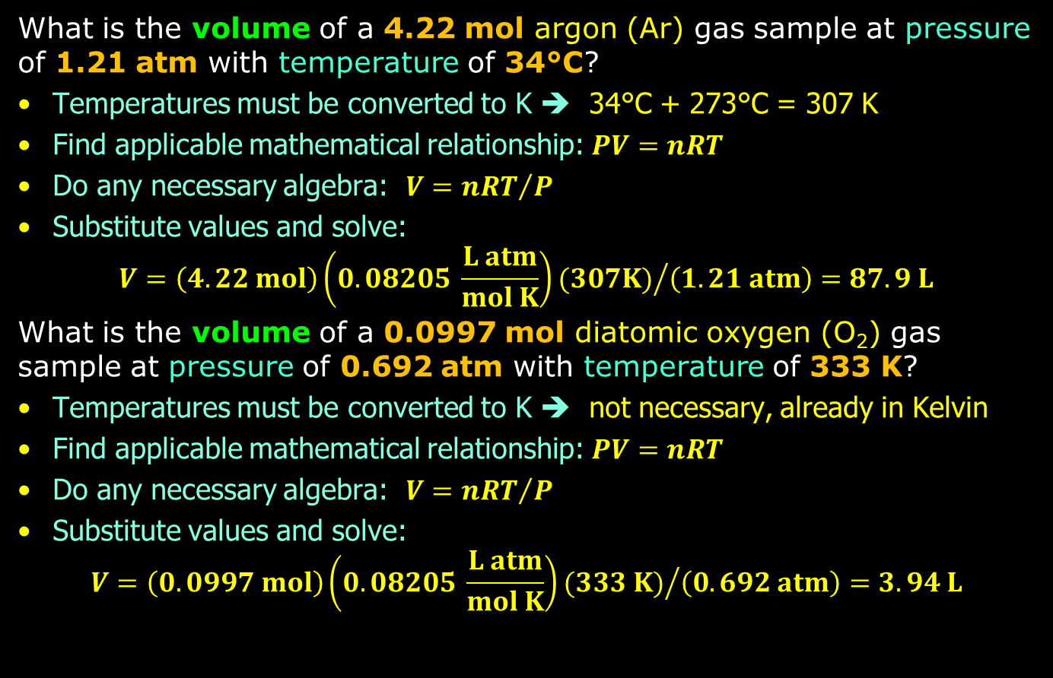
Ideal Gas Law Problem Practice
What is the volume of a 4.22 mol argon (Ar) gas sample at pressure of 1.21 atm with temperature of 34°C?
Temperatures must be converted to K ➔ 34°C + 273°C = 307 K
Find applicable mathematical relationship: $PV=nRT$
Do any necessary algebra: $V={nRT}/P$
Substitute values and solve:
$V={\left(4.22 mol\right)\left(0.08205 \frac{L atm}{mol K}\right)(307K)}/{\left(1.21 atm\right)}=87.9 L$
What is the volume of a 0.0997 mol diatomic oxygen (O₂) gas sample at pressure of 0.692 atm with temperature of 333 K?
Temperatures must be converted to K ➔ not necessary, already in Kelvin
Find applicable mathematical relationship: $PV=nRT$
Do any necessary algebra: $V={nRT}/P$
Substitute values and solve:
$V={\left(0.0997 mol\right)\left(0.08205 \frac{L atm}{mol K}\right)(333 K)}/{\left(0.692 atm\right)}=3.94 L$

Slide 25
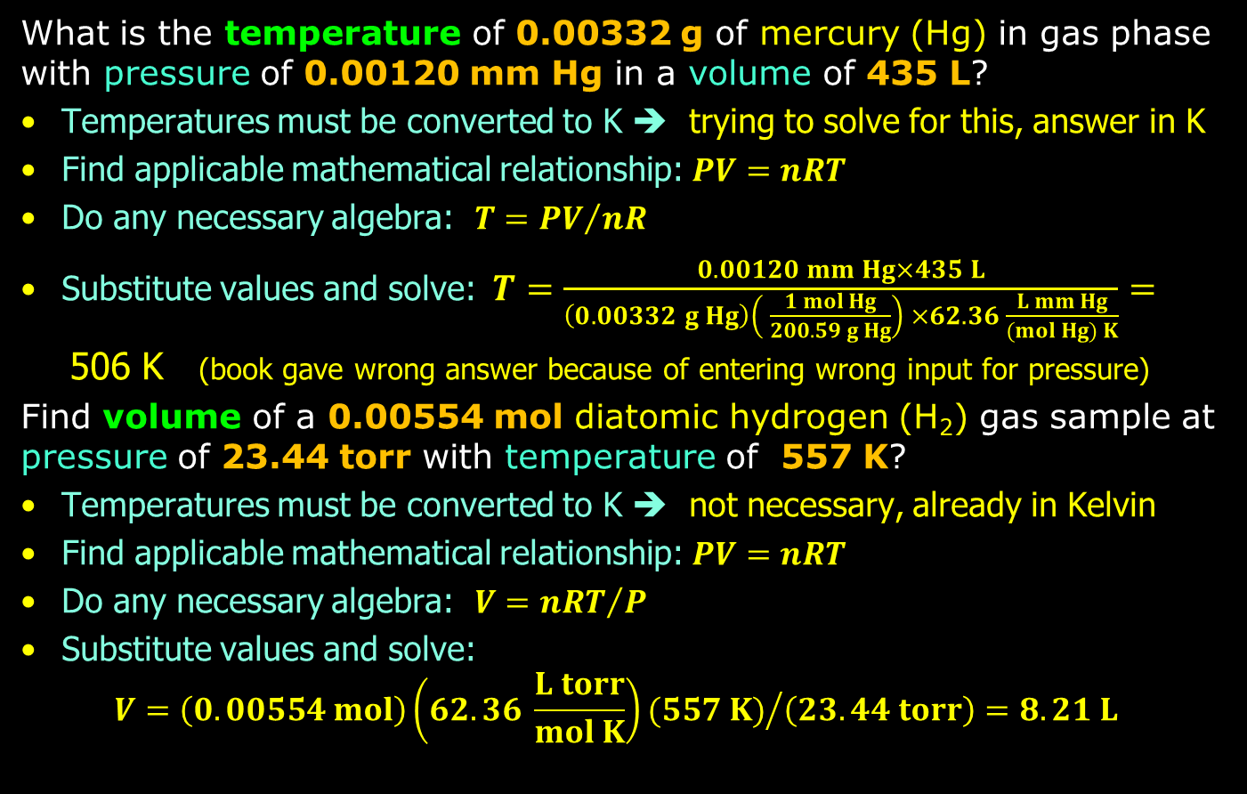
Ideal Gas Law Problem Practice
What is the temperature of 0.00332 g of mercury (Hg) in gas phase with pressure of 0.00120 mm Hg in a volume of 435 L?
Temperatures must be converted to K ➔ trying to solve for this, answer in K
Find applicable mathematical relationship: $PV=nRT$
Do any necessary algebra: $T={PV}/{nR}$
Substitute values and solve:$T=\frac{0.00120 mm Hg×435 L}{\left(0.00332 g Hg\right)\left( \frac{1 mol Hg}{200.59 g Hg}\right) ×62.36 \frac{L mm Hg}{(mol Hg) K}}=$506 K (book gave wrong answer because of entering wrong input for pressure)
Find volume of a 0.00554 mol diatomic hydrogen (H₂) gas sample at pressure of 23.44 torr with temperature of 557 K?
Temperatures must be converted to K ➔ not necessary, already in Kelvin
Find applicable mathematical relationship: $PV=nRT$
Do any necessary algebra: $V={nRT}/P$
Substitute values and solve:
$V={\left(0.00554 mol\right)\left(62.36 \frac{L torr}{mol K}\right)(557 K)}/{\left(23.44 torr\right)}=8.21 L$

Slide 26
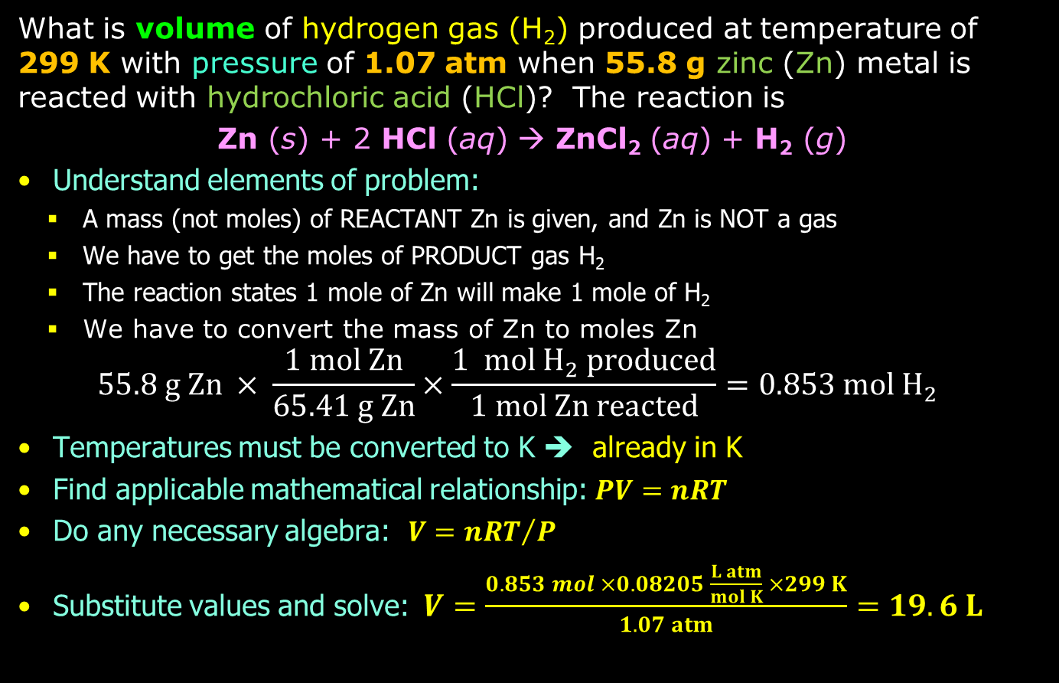
Ideal Gas Law Problem Practice
What is volume of hydrogen gas (H₂) produced at temperature of 299 K with pressure of 1.07 atm when 55.8 g zinc (Zn) metal is reacted with hydrochloric acid (HCl)? The reaction is
Zn (s) + 2 HCl (aq) → ZnCl₂ (aq) + H₂ (g)
Understand elements of problem:
  A mass (not moles) of REACTANT Zn is given, and Zn is NOT a gas
  We have to get the moles of PRODUCT gas H₂
  The reaction states 1 mole of Zn will make 1 mole of H₂
  We have to convert the mass of Zn to moles Zn
  $$55.8 g Zn × \frac{1 mol Zn}{65.41 g Zn}×\frac{1 mol H_{2} produced}{1 mol Zn reacted}=0.853 mol H_{2}$$
Temperatures must be converted to K ➔ already in K
Find applicable mathematical relationship: $PV=nRT$
Do any necessary algebra: $V={nRT}/P$
Substitute values and solve:$V=\frac{0.853 mol ×0.08205 \frac{L atm}{mol K} ×299 K}{1.07 atm}=19.6 L$

Slide 27
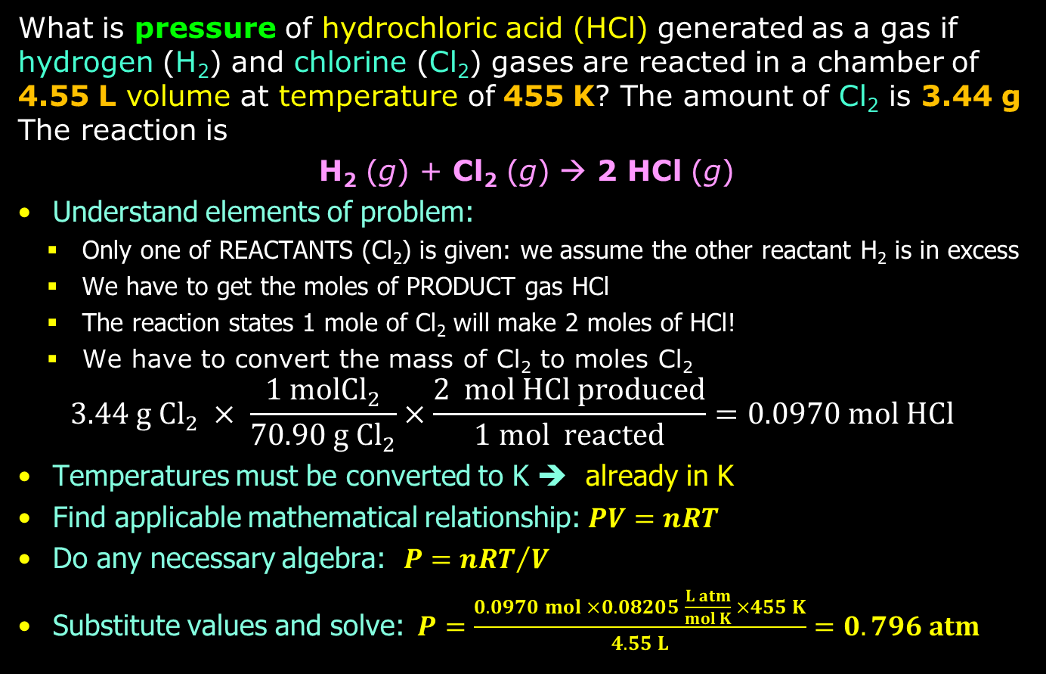
Ideal Gas Law Problem Practice
What is pressure of hydrochloric acid (HCl) generated as a gas if hydrogen (H₂) and chlorine (Cl₂) gases are reacted in a chamber of 4.55 L volume at temperature of 455 K? The amount of Cl₂ is 3.44 g The reaction is
H₂ (g) + Cl₂ (g) → 2 HCl (g)
Understand elements of problem:
  Only one of REACTANTS (Cl₂) is given: we assume the other reactant H₂ is in excess
  We have to get the moles of PRODUCT gas HCl
  The reaction states 1 mole of Cl₂ will make 2 moles of HCl!
  We have to convert the mass of Cl₂ to moles Cl₂
  $$3.44 g {Cl}_{2} × \frac{1 mol{Cl}_{2}}{70.90 g{ Cl}_{2}}×\frac{2 mol HCl produced}{1 mol reacted}=0.0970 mol HCl$$
Temperatures must be converted to K ➔ already in K
Find applicable mathematical relationship: $PV=nRT$
Do any necessary algebra: $P={nRT}/V$
Substitute values and solve:$P=\frac{0.0970 mol ×0.08205 \frac{L atm}{mol K} ×455 K}{4.55 L}=0.796 atm$

Slide 28
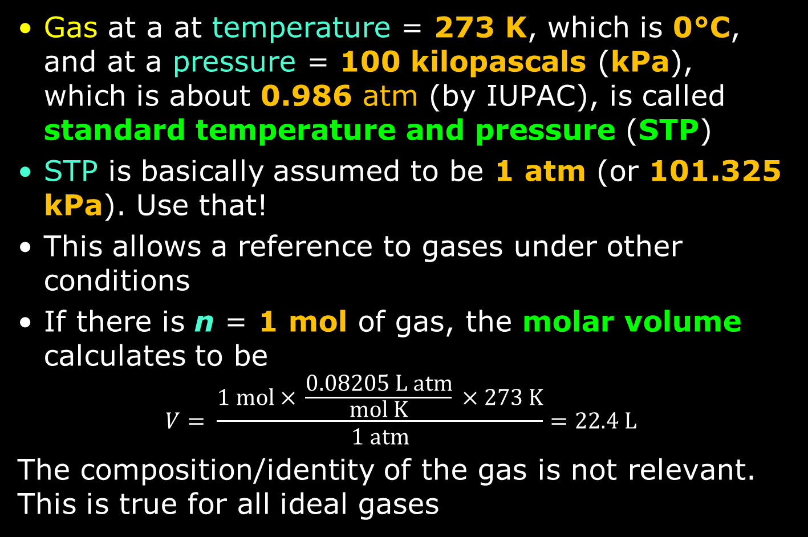
STP and Molar Volume
Gas at a at temperature = 273 K, which is 0°C, and at a pressure = 100 kilopascals (kPa), which is about 0.986 atm (by IUPAC), is called standard temperature and pressure (STP)
STP is basically assumed to be 1 atm (or 101.325 kPa). Use that!
This allows a reference to gases under other conditions
If there is n = 1 mol of gas, the molar volume calculates to be
$$V= \frac{1 mol × \frac{0.08205 L atm}{mol K} × 273 K}{1 atm}=22.4 L$$
The composition/identity of the gas is not relevant. This is true for all ideal gases

Slide 29
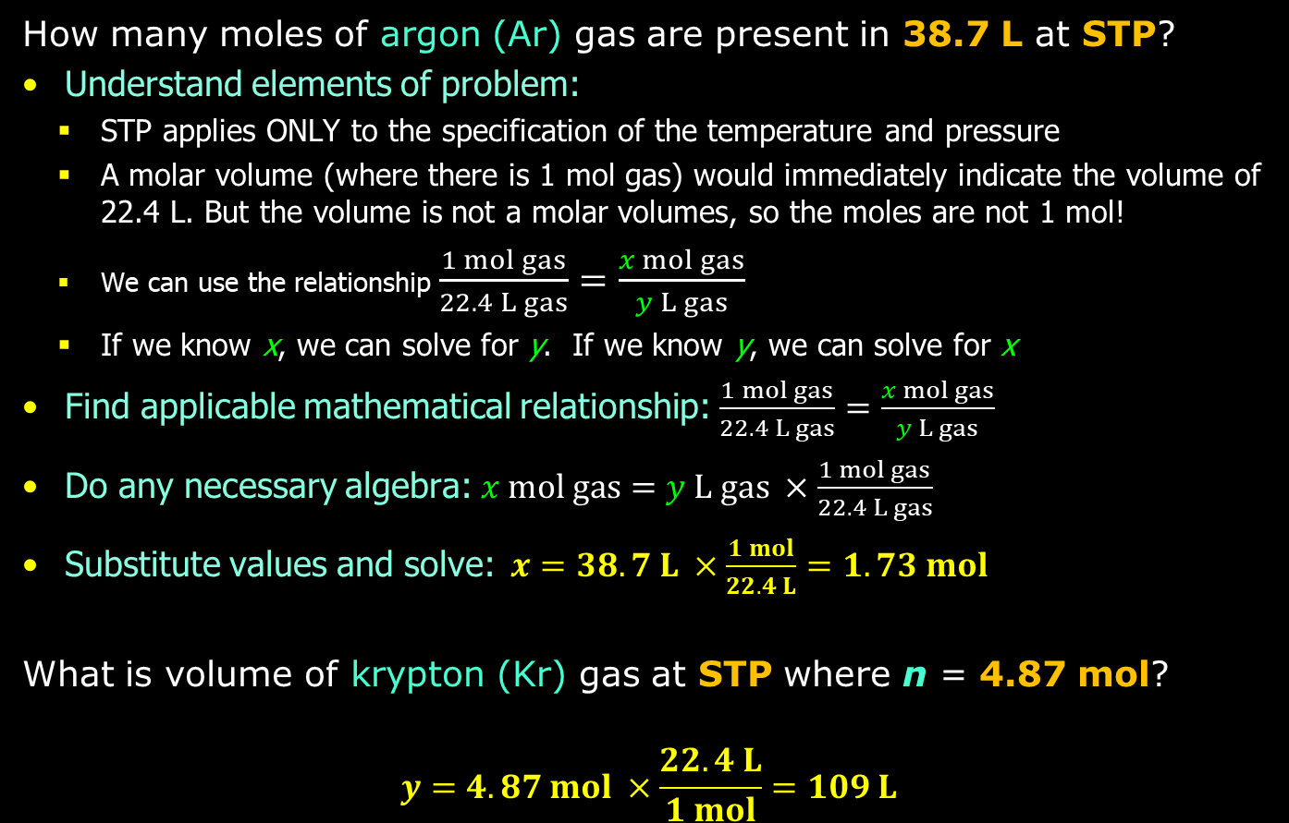
STP Problem Practice
How many moles of argon (Ar) gas are present in 38.7 L at STP?
Understand elements of problem:
  STP applies ONLY to the specification of the temperature and pressure
  A molar volume (where there is 1 mol gas) would immediately indicate the volume of 22.4 L. But the volume is not a molar volumes, so the moles are not 1 mol!
  We can use the relationship $\frac{1 mol gas}{22.4 L gas}=\frac{x mol gas}{y L gas}$
  If we know x, we can solve for y. If we know y, we can solve for x
Find applicable mathematical relationship: $\frac{1 mol gas}{22.4 L gas}=\frac{x mol gas}{y L gas}$
Do any necessary algebra:$x mol gas=y L gas ×\frac{1 mol gas}{22.4 L gas}$
Substitute values and solve:$x=38.7 L ×\frac{1 mol}{22.4 L}=1.73 mol$
What is volume of krypton (Kr) gas at STP where n = 4.87 mol?
$$y=4.87 mol ×\frac{22.4 L}{1 mol}=109 L$$

Slide 30
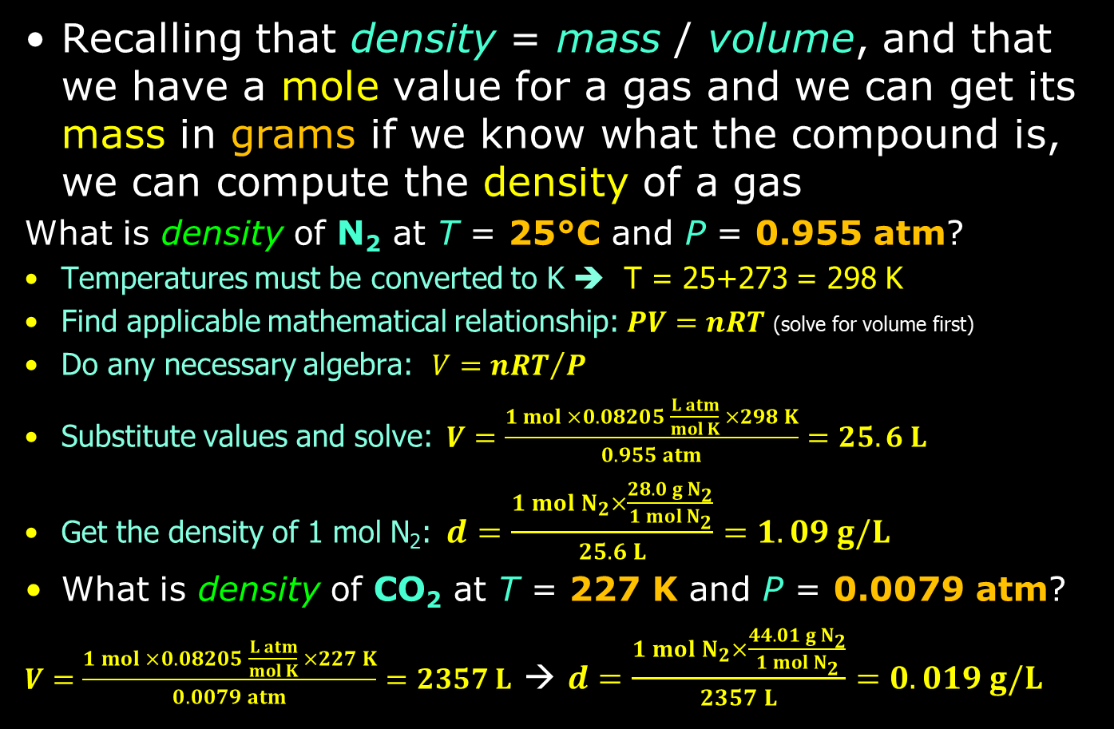
Gas Density
Recalling that density = mass / volume, and that we have a mole value for a gas and we can get its mass in grams if we know what the compound is, we can compute the density of a gas
What is density of N₂ at T = 25°C and P = 0.955 atm?
Temperatures must be converted to K ➔ T = 25+273 = 298 K
Find applicable mathematical relationship: $PV=nRT$ (solve for volume first)
Do any necessary algebra: $V={nRT}/P$
Substitute values and solve:$V=\frac{1 mol ×0.08205 \frac{L atm}{mol K} ×298 K}{0.955 atm}=25.6 L$
Get the density of 1 mol N₂:$d=\frac{1 mol N_{2}×\frac{28.0 g N_{2}}{1 mol N_{2}}}{25.6 L}=1.09 g/L$
What is density of CO₂ at T = 227 K and P = 0.0079 atm?
$V=\frac{1 mol ×0.08205 \frac{L atm}{mol K} ×227 K}{0.0079 atm}=2357 L$ → $d=\frac{1 mol N_{2}×\frac{44.01 g N_{2}}{1 mol N_{2}}}{2357 L}=0.019 g/L$

Slide 31
Gas Mixtures
Gas pressure is created by particles colliding with each other and container walls
As particles (moles) are added, to the pressure increases (PV = nRT)
This is true no matter the composition of the gas → gas mixtures
Dalton showed that if the air is 78% N₂ and 21% O₂, then N₂ was responsible for 0.78 of pressure P and O₂ was responsible for 0.21 of pressure P
So if air is at 1 atm, P for N₂ = 0.78 atm and P for O₂ = 0.21 atm

Slide 32
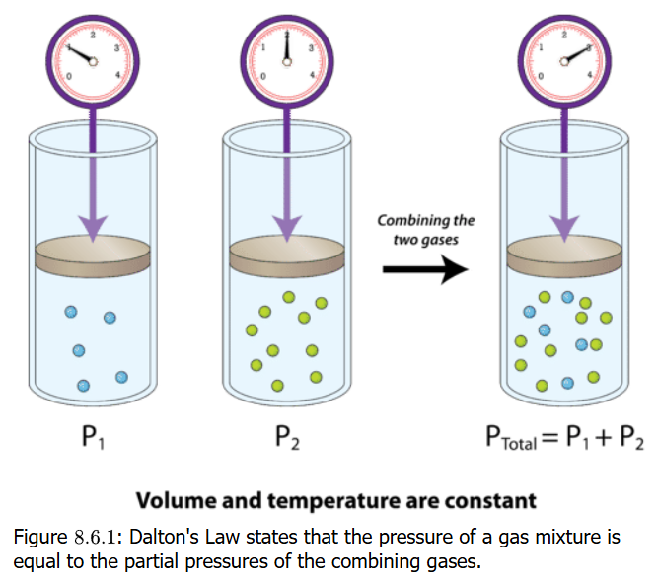
Dalton’s Law of Partial Pressures
Suppose a container of gas at P₁ and another container of gas at P₂
If the two gases are combined in a container at same volume and temperature, the pressure of the combination is the sum of the individual pressures
P_{total} = P₁ + P₂

Slide 33


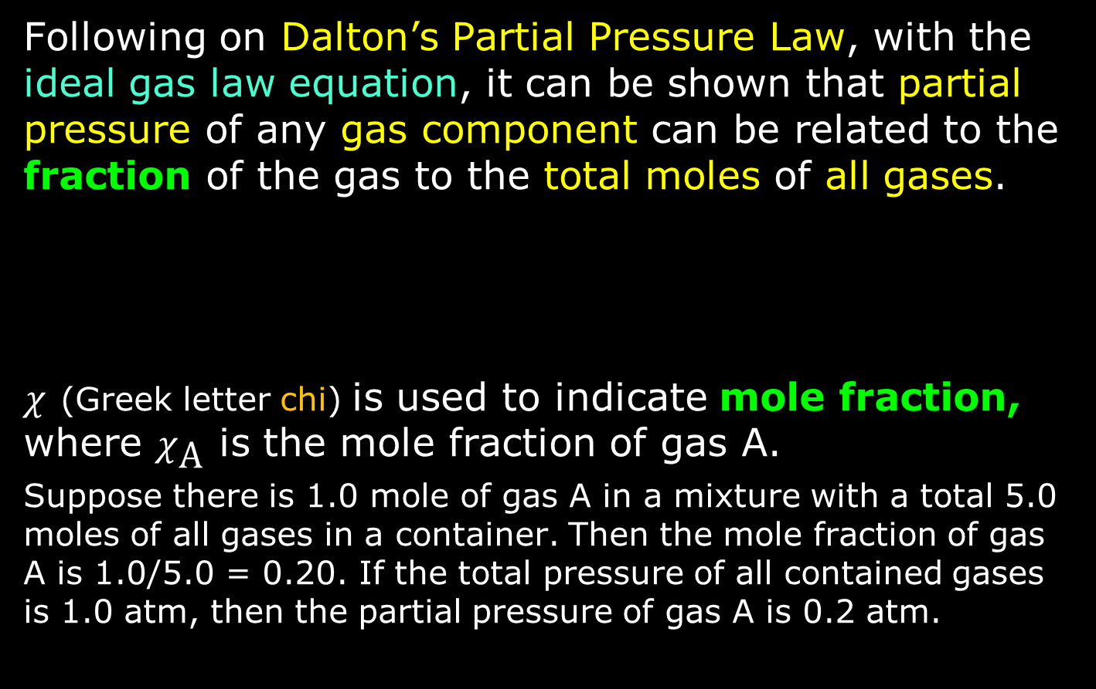
Mole Fraction of Gases
Following on Dalton’s Partial Pressure Law, with the ideal gas law equation, it can be shown that partial pressure of any gas component can be related to the fraction of the gas to the total moles of all gases.
$χ$ (Greek letter chi) is used to indicate mole fraction, where $χ_{\text{A}}$ is the mole fraction of gas A.
Suppose there is 1.0 mole of gas A in a mixture with a total 5.0 moles of all gases in a container. Then the mole fraction of gas A is 1.0/5.0 = 0.20. If the total pressure of all contained gases is 1.0 atm, then the partial pressure of gas A is 0.2 atm.

Slide 34
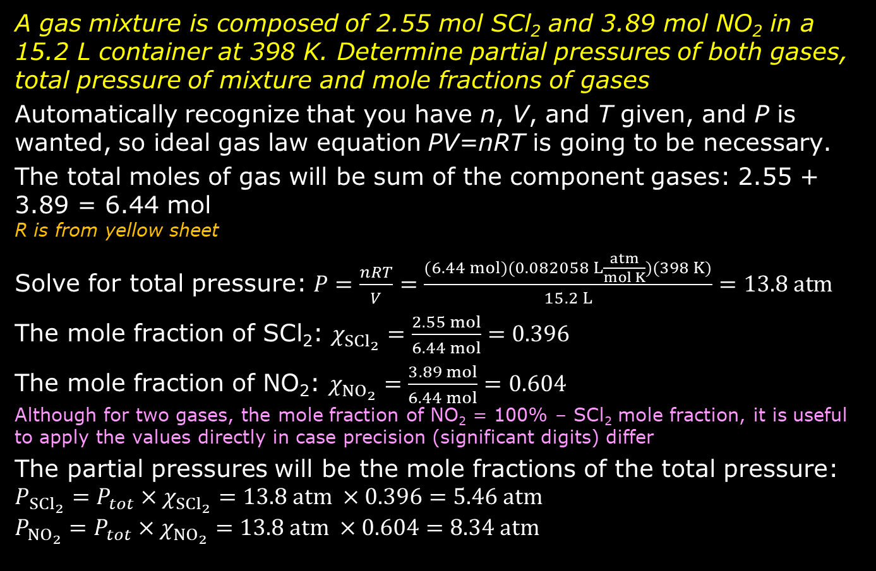
Practice: Partial Pressures & Mole Fractions
A gas mixture is composed of 2.55 mol SCl₂ and 3.89 mol NO₂ in a 15.2 L container at 398 K. Determine partial pressures of both gases, total pressure of mixture and mole fractions of gases
Automatically recognize that you have n, V, and T given, and P is wanted, so ideal gas law equation PV=nRT is going to be necessary.
The total moles of gas will be sum of the component gases: 2.55 + 3.89 = 6.44 mol
R is from yellow sheet
Solve for total pressure: $P=\frac{nRT}{V}=\frac{(6.44 mol)(0.082058 L\frac{atm}{mol K})(398 K)}{15.2 L}=13.8 atm$
The mole fraction of SCl₂: $χ_{{SCl}_{2}}=\frac{2.55 mol}{6.44 mol}=0.396$
The mole fraction of NO₂: $χ_{{NO}_{2}}=\frac{3.89 mol}{6.44 mol}=0.604$
Although for two gases, the mole fraction of NO₂ = 100% – SCl₂ mole fraction, it is useful to apply the values directly in case precision (significant digits) differ
The partial pressures will be the mole fractions of the total pressure:
$$P_{{SCl}_{2}}=P_{tot}×χ_{{SCl}_{2}}=13.8 atm ×0.396=5.46 atm$$
$$P_{{NO}_{2}}=P_{tot}×χ_{{NO}_{2}}=13.8 atm ×0.604=8.34 atm$$

Slide 35
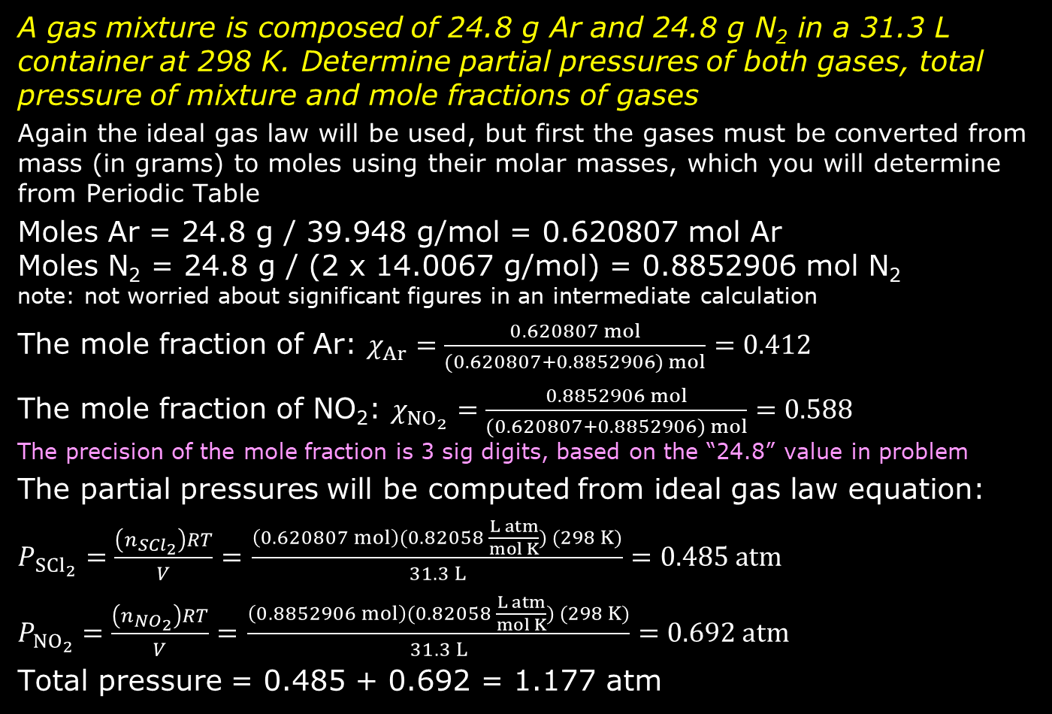
Practice: Partial Pressures & Mole Fractions
A gas mixture is composed of 24.8 g Ar and 24.8 g N₂ in a 31.3 L container at 298 K. Determine partial pressures of both gases, total pressure of mixture and mole fractions of gases
Again the ideal gas law will be used, but first the gases must be converted from mass (in grams) to moles using their molar masses, which you will determine from Periodic Table
Moles Ar = 24.8 g / 39.948 g/mol = 0.620807 mol Ar
Moles N₂ = 24.8 g / (2 x 14.0067 g/mol) = 0.8852906 mol N₂
note: not worried about significant figures in an intermediate calculation
The mole fraction of Ar: $χ_{Ar}=\frac{0.620807 mol}{(0.620807+0.8852906) mol}=0.412$
The mole fraction of NO₂: $χ_{{NO}_{2}}=\frac{0.8852906 mol}{(0.620807+0.8852906) mol}=0.588$
The precision of the mole fraction is 3 sig digits, based on the “24.8” value in problem
The partial pressures will be computed from ideal gas law equation:
$P_{{SCl}_{2}}=\frac{\left(n_{{SCl}_{2}}\right)RT}{V}=$ $\frac{\left(0.620807 mol\right)(0.82058 \frac{L atm}{mol K}) (298 K)}{31.3 L}=0.485 atm$
$P_{{NO}_{2}}=\frac{\left(n_{{NO}_{2}}\right)RT}{V}=$ $\frac{\left(0.8852906 mol\right)(0.82058 \frac{L atm}{mol K}) (298 K)}{31.3 L}=0.692 atm$
Total pressure = 0.485 + 0.692 = 1.177 atm

Slide 36
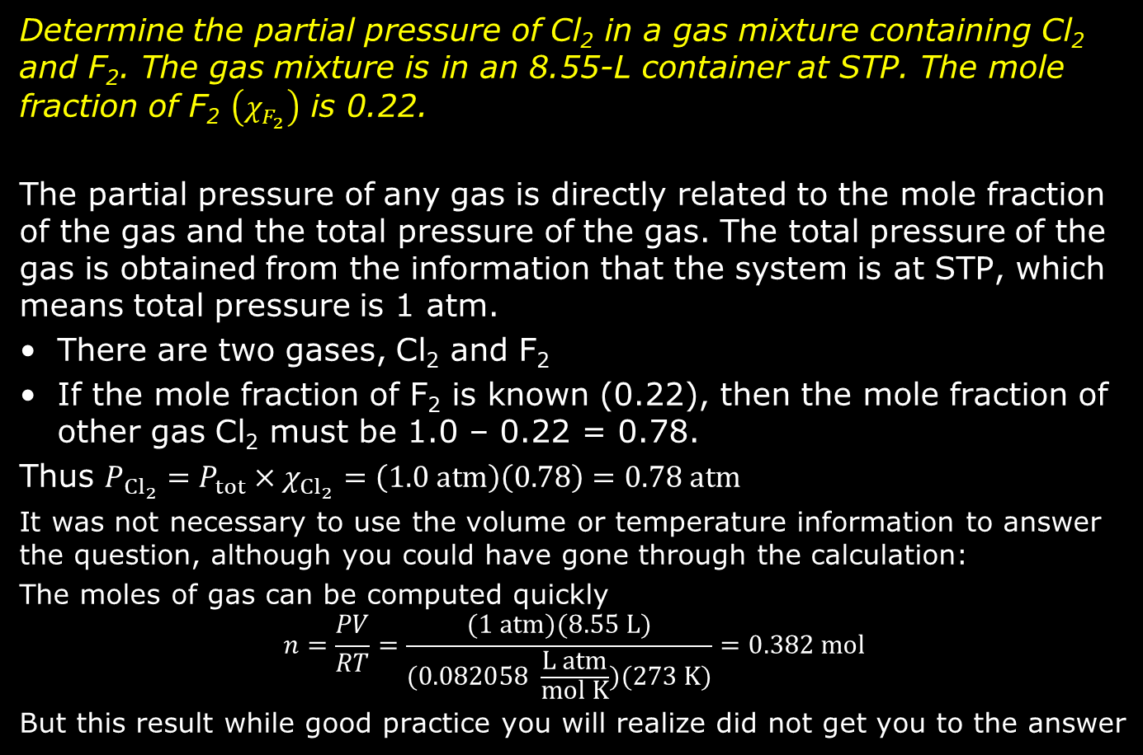
Practice: Partial Pressures & Mole Fractions
Determine the partial pressure of Cl₂ in a gas mixture containing Cl₂ and F₂. The gas mixture is in an 8.55-L container at STP. The mole fraction of F₂ $\left(χ_{F_{2}}\right)$ is 0.22.
The partial pressure of any gas is directly related to the mole fraction of the gas and the total pressure of the gas. The total pressure of the gas is obtained from the information that the system is at STP, which means total pressure is 1 atm.
There are two gases, Cl₂ and F₂
If the mole fraction of F₂ is known (0.22), then the mole fraction of other gas Cl₂ must be 1.0 – 0.22 = 0.78.
Thus $P_{{Cl}_{2}}=P_{tot}×χ_{{Cl}_{2}}=\left(1.0 atm\right)\left(0.78\right)=0.78 atm$
It was not necessary to use the volume or temperature information to answer the question, although you could have gone through the calculation:
The moles of gas can be computed quickly
$$n=\frac{PV}{RT}=\frac{(1 atm)(8.55 L)}{(0.082058 \frac{L atm}{mol K})(273 K)}=0.382 mol$$
But this result while good practice you will realize did not get you to the answer

Slide 37
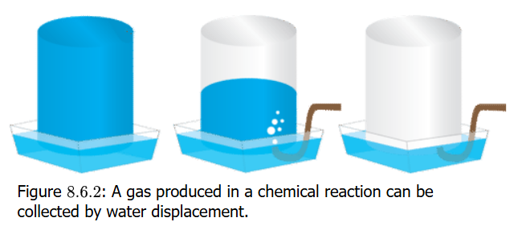
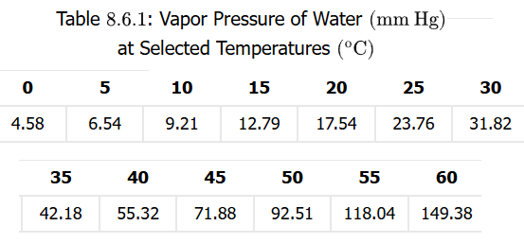
Gas Displacement of Water
In the laboratory, you have a container filled with water whose opening is inverted in an outer container
You do an experiment where you produce gas up into the inverted container and the gas displaces the water
The pressure of the contained gas is equal to the pressure outside of the container (namely the atmosphere, where P = 1 atm). So this helps in calculating the amount of gas produced.
Water vapor contributes as well, so we have to compensate for its effect on pressure

Slide 38
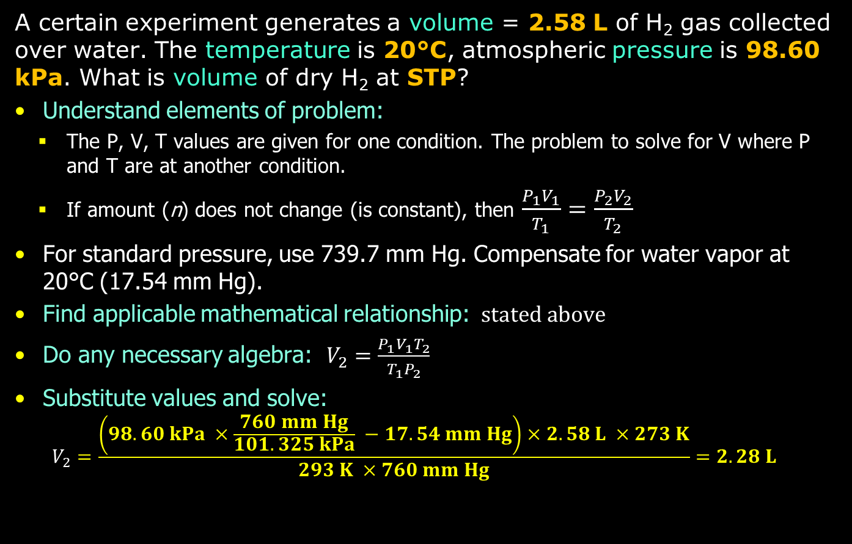
Gas Displacement Problem Practice
A certain experiment generates a volume = 2.58 L of H₂ gas collected over water. The temperature is 20°C, atmospheric pressure is 98.60 kPa. What is volume of dry H₂ at STP?
Understand elements of problem:
  The P, V, T values are given for one condition. The problem to solve for V where P and T are at another condition.
  If amount (n) does not change (is constant), then $\frac{P_{1}V_{1}}{T_{1}}=\frac{P_{2}V_{2}}{T_{2}}$
For standard pressure, use 739.7 mm Hg. Compensate for water vapor at 20°C (17.54 mm Hg).
Find applicable mathematical relationship: $stated above$
Do any necessary algebra: $V_{2}=\frac{P_{1}V_{1}T_{2}}{T_{1}P_{2}}$
Substitute values and solve:
  $$V_{2}=\frac{\left(98.60 kPa ×\frac{760 mm Hg}{101.325 kPa} −17.54 mm Hg\right)×2.58 L ×273 K}{293 K ×760 mm Hg}=2.28 L$$

